Slide 1
Topic: Non Linear Parabolas

Slide 2
Intro
As they walk in play a few times
https://www.youtube.com/watch?v=cXOcBADMp6o
https://www.youtube.com/watch?v=He42k1xRpbQ
Then discuss the what a parabola is…
Watch
https://www.youtube.com/watch?v=lbMir1UAO4I
Discuss Real life applications

Slide 3
Contents
Glossary or Formula Page
Page
Date
Description
2
3

Slide 4
Tasks
24
7
30
Essential Question
Questions
Notes
Summary
4
5

Slide 5
24
7
30
Date
Non-Linear Geometry
Parabolas
What is a parabola?
5

Slide 6
24
7
30
Date
Non-Linear Geometry
Parabolas
What is a parabola?
A parabola is the graph of a quadratic relation.
5

Slide 7
24
7
30
Date
Non-Linear Geometry
Parabolas
What is a parabola?
A parabola is the graph of a quadratic relation.
The basic parabola has the rule y = x².
5

Slide 8
24
7
30
Date
Non-Linear Geometry
Parabolas
What is a parabola?
A parabola is the graph of a quadratic relation.
The basic parabola has the rule y = x².
Features of a parabola
5

Slide 9
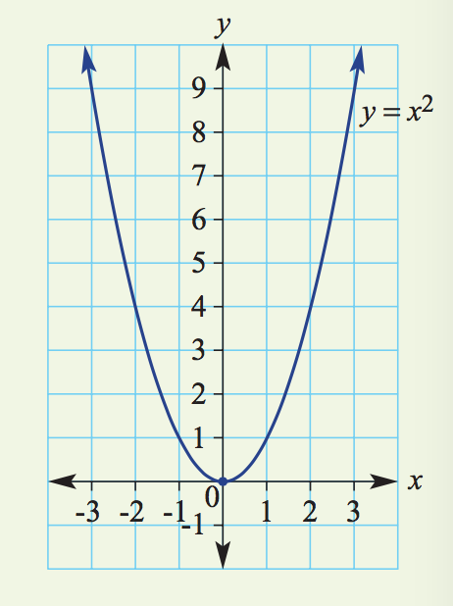
24
7
30
Date
Non-Linear Geometry
Parabolas
What is a parabola?
A parabola is the graph of a quadratic relation.
The basic parabola has the rule y = x².
Features of a parabola
5

Slide 10
24
7
30
Date
Non-Linear Geometry
Parabolas
What is a parabola?
A parabola is the graph of a quadratic relation.
The basic parabola has the rule y = x².
Features of a parabola
– The vertex (or turning point) is (0, 0). – It is a minimum turning point.
– Axis of symmetry is x = 0. – y-intercept is (0, 0). – x-intercept is (0, 0).
5

Slide 11
24
7
30
Date
Non-Linear Geometry
Parabolas
What is a Turning Point?
5

Slide 12
24
7
30
Date
Non-Linear Geometry
Parabolas
What is a Turning Point?
The turning point is the point in which the parabola changes direction
5

Slide 13
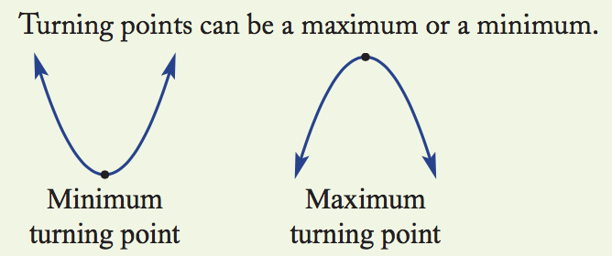
24
7
30
Date
Non-Linear Geometry
Parabolas
What is a Turning Point?
The turning point is the point in which the parabola changes direction
5

Slide 14
24
7
30
Date
Non-Linear Geometry
Parabolas
What is a Turning Point?
The turning point is the point in which the parabola changes direction
If positive, ie y=3x² the parabola opens up
5

Slide 15
24
7
30
Date
Non-Linear Geometry
Parabolas
What is a Turning Point?
The turning point is the point in which the parabola changes direction
If positive, ie y=3x² the parabola opens up
5

Slide 16
24
7
30
Date
Non-Linear Geometry
Parabolas
What is a Turning Point?
The turning point is the point in which the parabola changes direction
If positive, ie y=3x² the parabola opens up
If negative, ie y=-3x² the parabola opens down
5

Slide 17
24
7
30
Date
Non-Linear Geometry
Parabolas
What is a Turning Point?
The turning point is the point in which the parabola changes direction
If positive, ie y=3x² the parabola opens up
If negative, ie y=-3x² the parabola opens down
5

Slide 18
24
7
30
Date
Non-Linear Geometry
Parabolas
What is a Turning Point?
The turning point is the point in which the parabola changes direction
Concave up
If positive, ie y=3x² the parabola opens up
If negative, ie y=-3x² the parabola opens down
This is also know as
Concave down
5

Slide 19
24
7
30
Date
Non-Linear Geometry
Parabolas
What is the y- intercept?
5

Slide 20
24
7
30
Date
Non-Linear Geometry
Parabolas
What is the y- intercept?
Where the parabola crosses the Y axis
A parabola has only 1 y -intercept
5

Slide 21
24
7
30
Date
Non-Linear Geometry
Parabolas
What is the y- intercept?
Where the parabola crosses the Y axis
A parabola has only 1 y -intercept
What is the x- intercept?
5

Slide 22
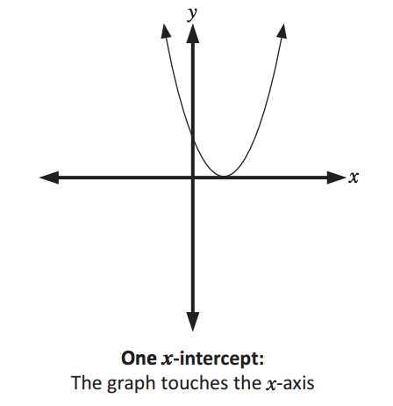
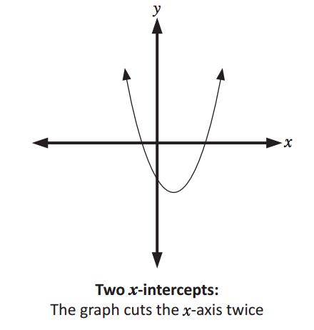
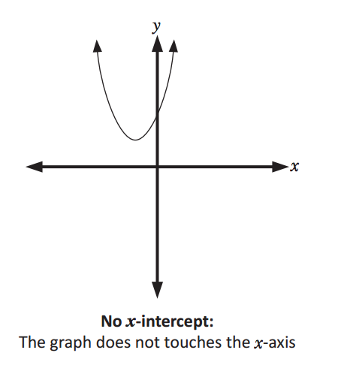
24
7
30
Date
Non-Linear Geometry
Parabolas
What is the y- intercept?
Where the parabola crosses the Y axis
A parabola has only 1 y -intercept
What is the x- intercept?
Where the parabola crosses the x axis
A parabola can have
no x intercept 1 x- intercepts Or a maximum of 2 x-intercepts
5

Slide 23
24
7
30
Date
Non-Linear Geometry
Parabolas
What is the axis of Symmetry?
5

Slide 24
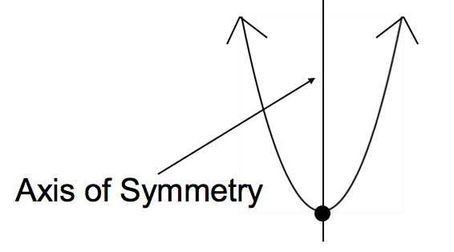
24
7
30
Date
Non-Linear Geometry
Parabolas
What is the axis of Symmetry?
The axis of symmetry (axis) is the line that cuts the parabola in half
It is located at x = ?.
5

Slide 25
24
7
30
Date
Non-Linear Geometry
Parabolas
What is the axis of Symmetry?
The axis of symmetry (axis) is the line that cuts the parabola in half
It is located at x = ?.
5

Slide 26
24
7
30
Date
Non-Linear Geometry
Parabolas
What type of Equations that form Parabolas?
All quadratic equations for parabolas when plotted on a Cartesian plane (or graphed)
For example
y=x²
This is the most basic quadratic formula or form
But they can also look like
y=3x²
or
y=10x²
or
y=230x²
y=-3x²
or
y=-763x²
y=(x - 2)²
or
y=x² - 5
or
………..
The list can go on
and on
But the most important thing to remember is that all quadratics have x to the power of 2
x²
5

Slide 27
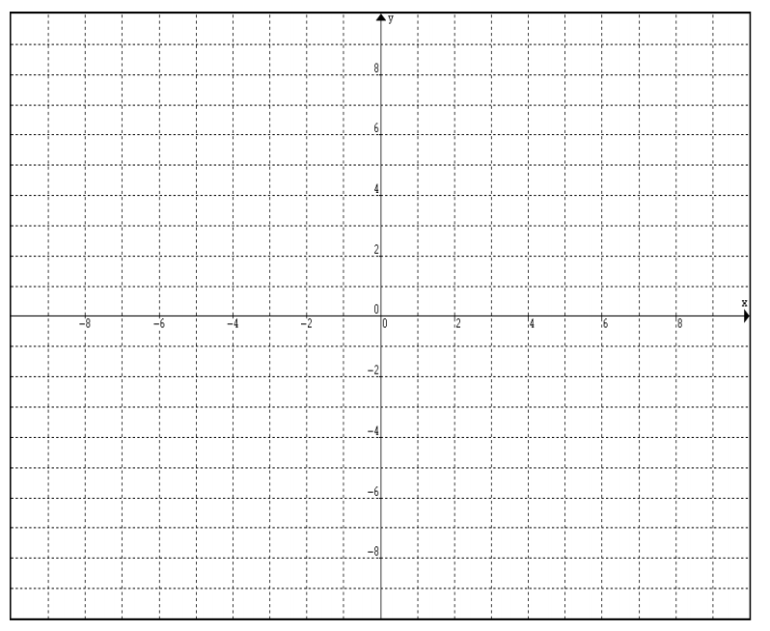
Now lets try plotting some parabolas from a quadratic equation
x | -3 | -2 | -1 | 0 | 1 | 2 | 3
y
y=x²

Slide 28
x | -3 | -2 | -1 | 0 | 1 | 2 | 3
y
y=2x²

Slide 29
x | -3 | -2 | -1 | 0 | 1 | 2 | 3
y
y=-x²

Slide 30
x | -3 | -2 | -1 | 0 | 1 | 2 | 3
y
y=x²-3

Slide 31
y=(x-1)²
x | -3 | -2 | -1 | 0 | 1 | 2 | 3
y

Slide 32
Close with watching
https://www.youtube.com/watch?v=HOiH1eVCggw

Slide 33
Notes Review
24, 7 ,30
Date
Title
Essential question
Notes complete
Notes complete with colour and diagrams
Questions completed
Contents page filed in
Formula page filled in

Slide 34
Homework
Complete any unfinished graphs
Review your notes and write a summary answering the essential question.

